Slide 1
VIPS image processing system for scientific imaging
Introduction
Why is VIPS potentially useful
History of VIPS
The VIPS GUI
Colorimetric and multispectral imaging
Large images in web pages
RTI imaging
Image shrinking
IR reflectogram assembly
Dr John Cupitt
Department of Medicine
Imperial College
London, UK
http://www.vips.ecs.soton.ac.uk
Rode Imaging Event, 2014

Slide 2
Introduction
VIPS is a free 2D scientific image processing system.
Needs little memory, runs quickly
Good support for large images and for colour
C, C++, Python, Ruby, JavaScript, command-line
Runs on any Unix and on Windows
Has an advanced GUI, nip2, a blend of a spreadsheet and a paint program

Slide 3
Speed and memory use
i5-3210M CPU @ 2.50GHz (Dell Vostro laptop)
Load, crop, shrink, sharpen and save a 5,000 x 5,000 pixel RGB TIFF image. Fastest real time of three runs on a quiet system.
nip2 seems slow because it has a long start-up time: once it starts, it processes at the same speed as the Python and C++ versions. Source-code for the various implementations plus a driver program here:
https://github.com/jcupitt/vips-bench

Slide 4
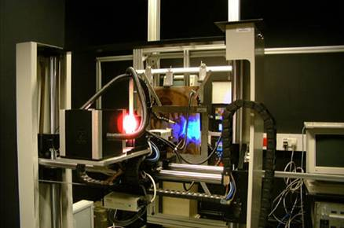
History
VIPS was started in 1990 as the image processing system for the VASARI project (multispectral imaging of old-master paintings to detect long-term colour change).
10,000 x 10,000 pixels, seven colour bands, 16 bits per band, up to 1.6 GB for the final image.
Our Sun4 had 64 MB of RAM and a 25 Mhz processor. Ouch!

Slide 5
History
Most image processing systems work like this:
Images are pushed left-to-right one at a time and must be entirely loaded into memory.
This would not have worked for us, we needed something different.

Slide 6
History
VIPS works something like this:
Small tiles are pulled right-to-left, each thread runs a copy of the whole pipeline, the whole image is never present all at once.

Slide 7
Speed and memory use
i5-3210M CPU @ 2.50GHz (Dell Vostro laptop)
Load, crop, shrink, sharpen and save a 5,000 x 5,000 pixel RGB TIFF image. Fastest real time of three runs on a quiet system.
nip2 seems slow because it has a long start-up time: once it starts, it processes at the same speed as the Python and C++ versions. Source-code for the various implementations plus a driver program here:
https://github.com/jcupitt/vips-bench

Slide 8
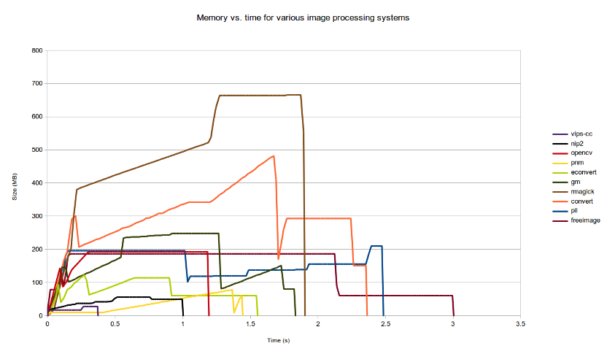
Speed and memory use

Slide 9
GUI
Push vs. pull sets the type of GUI that can be made. The canonical push GUI is PhotoShop: you load an image, repeatedly modify it, and save again.
Low memory use enables a new type of GUI. Instead of operations over time, we can show all the stages of a long sequence of operations at the same time.

Slide 10
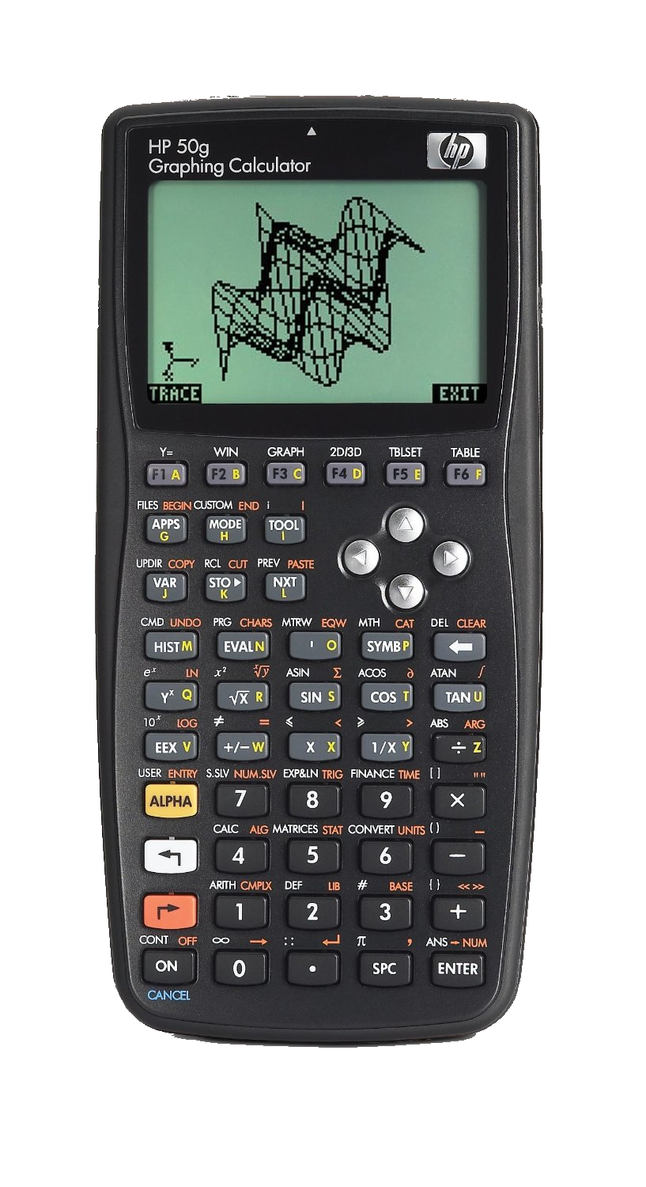
GUI

Slide 11
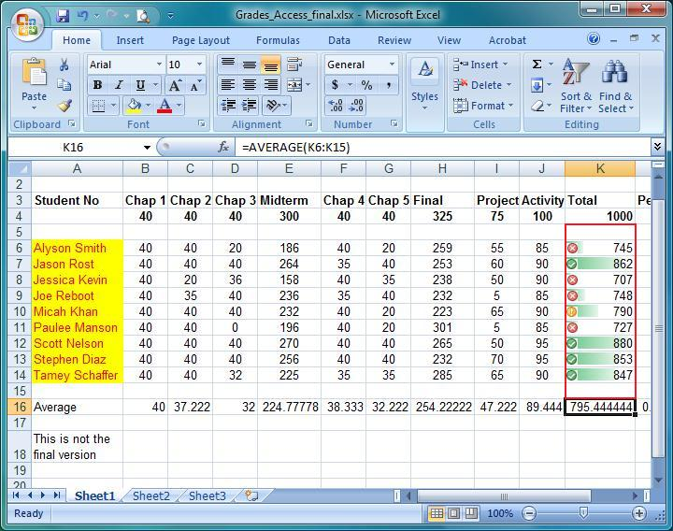
GUI

Slide 12
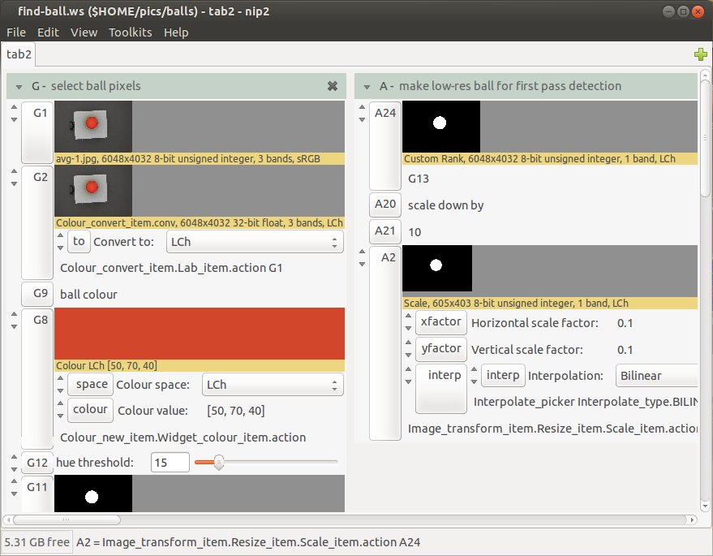
GUI
nip2, the VIPS GUI, is a spreadsheet where each cell can be a complex object: an image, plot, widget, matrix, etc.

Slide 13
GUI
nip2 includes a programming langage and can be used for quite large, complex applications.
I use it for analysing PET scans, for example. This workspace has 13 tabs, reads 300MB of image data, processes 7,000 images (60 GB in total) and takes 2 minutes to completely recalculate. It needs only 400 MB of memory to run.

Slide 14
CHARISMA
The CHARISMA project has produced a nip2 workspace to automate and standardise museum technical imaging.
Camera calibration
Visible light colorimetry with a Macbeth chart
IR and UV reflectance imaging via Spectralon targets
UV-induced visible flourescence and visible-induced IR flourecence
Kubelka-Munk correction of flourescence images

Slide 15
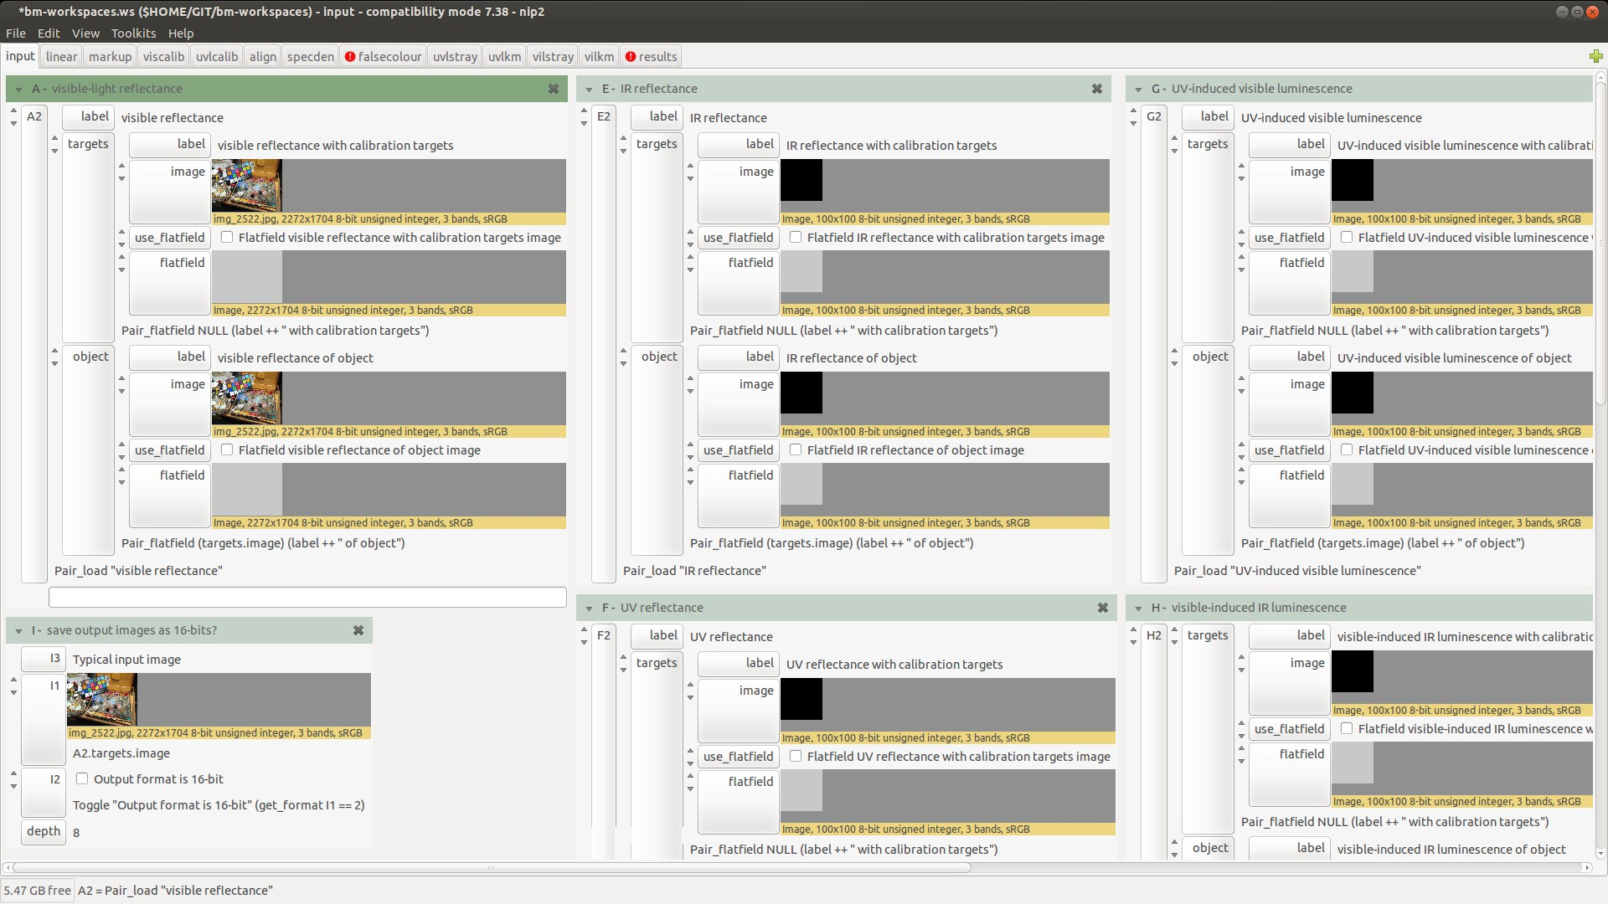
CHARISMA

Slide 16
Large images in web pages
There are many ways of putting a large image in a web page. They almost all need an image pyramid on the server.
IIPImage needs a web server extension and a tiled pyramidal TIFF image.
DeepZoom / Zoomify / Google Maps work with any web server but need a big directory free of tiles.
VIPS can build both types of pyramid quickly and with no size limits.

Slide 17
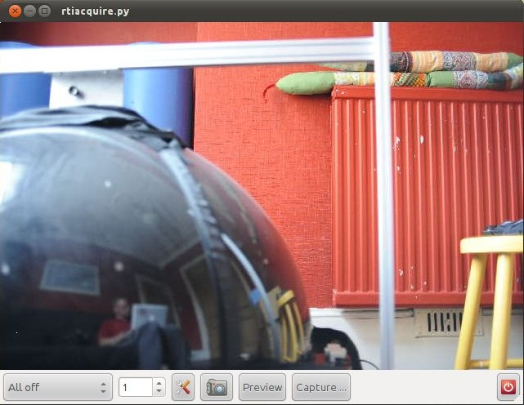
RTI imaging
RTIAcquire allows remote control of any DSLR camera and automates rti capture.
ptmfit is a port of Tom's original fitter to VIPS: any size image, runs quickly.

Slide 18
Other applications
Websites need to shrink uploaded images for display.
VIPS includes vipsthumbnail, a fast image shrinker with low memory needs. Used by booking.com, wikipedia, others.
nip2 includes operations for image mosaic assembly. Useful for IR reflectogram mosaic assembly and X-rays.

